Slide 1

AI Agents:
Architecture & Applications
A comprehensive masterclass for building autonomous, reasoning-capable AI systems in 2026.

Slide 2
The value of AI is no longer just in answering questions, but in acting autonomously within defined constraints to achieve complex goals.
"
"
— The Shift from Chatbots to Agents

Slide 3
Part 1: Core Concepts
Understanding the fundamental difference between standard Large Language Models and Agentic Systems.

Slide 4
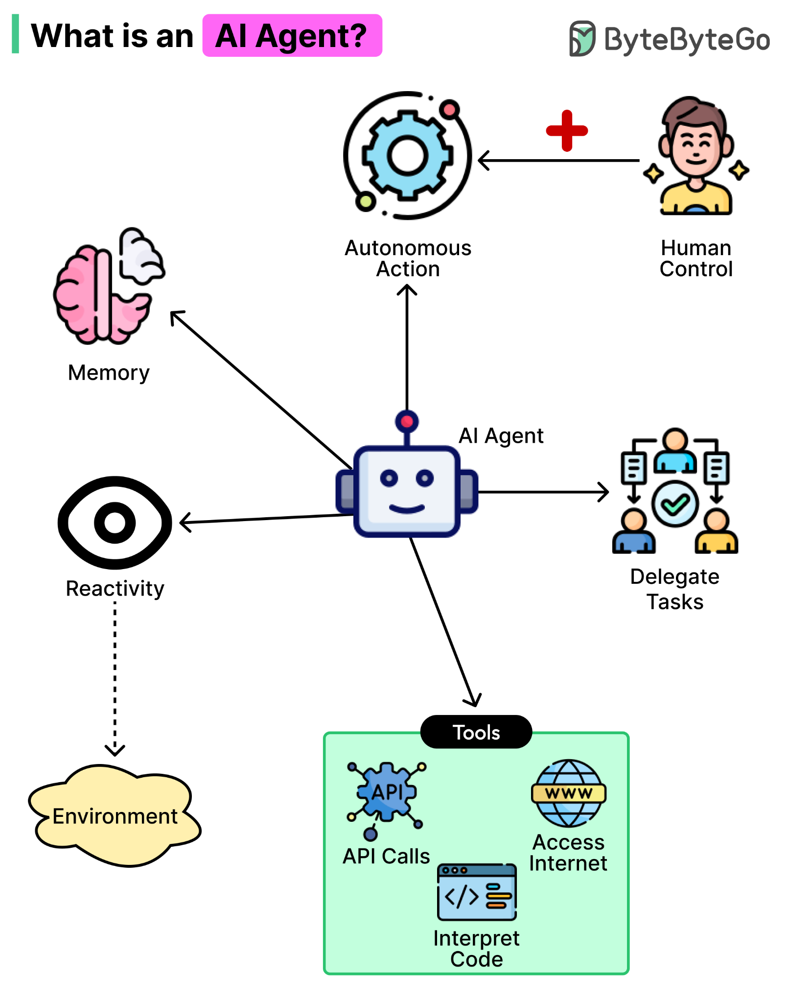
What is an AI Agent?
▹
Beyond Text Generation: While standard LLMs only generate text based on prompts, agents possess the ability to perceive, decide, and act.
▹
Autonomy: They operate in continuous loops, breaking down high-level instructions into executable sub-tasks.
▹
Tool Orchestration: Agents can trigger external APIs, search the web, execute code, and query databases in real-time.
▹
State Management: They maintain context and adapt their strategy if an initial approach fails.

Slide 5












Four Foundational Layers
Perception
Reasoning
Memory
Tools
Input processing that transforms raw text, APIs, or sensor data into a structured format the reasoning engine can parse.
The core LLM engine responsible for decision-making, planning, tool selection, and adapting to unexpected outcomes.
Systems maintaining short-term conversation state (context window) and long-term episodic recall (Vector DBs).
Execution layers utilizing Function Calling and MCPs (Model Context Protocol) to integrate with enterprise APIs.

Slide 6
The 2026 Landscape
Rapid Industry Adoption
By the end of 2026, Gartner projects that 40% of all enterprise applications will feature task-specific AI agents, scaling dramatically from less than 5% in early 2025.
40%
This is reflected in developer activity, with GitHub reporting over 4.3 million AI-related repositories—a 178% year-over-year jump driven largely by agentic workflows and LLMOps frameworks.
of Enterprise Apps (Gartner)

Slide 7
Part 2: Architecture
Designing patterns that balance AI autonomy with predictable system reliability.

Slide 8


Agentic Design Patterns
Single-Agent Orchestrator
Multi-Agent Systems (Swarm)
A single, highly capable model acts as the central router, accessing all tools and sequentially executing the workflow.
A network of specialized micro-agents (e.g., Researcher, Coder, Reviewer) collaborating to solve complex problems.
▹
Best for tightly-scoped, linear tasks.
▹
Best for highly parallelized or fan-out tasks.
▹
Easier to debug and trace state changes.
▹
Reduces token load by keeping individual prompts focused.
▹
Prone to "context stuffing" if given too many tools.
▹
Requires robust orchestration to prevent infinite loops.

Slide 9

Reasoning & Planning
Chain of Thought (CoT): Forcing the LLM to generate a step-by-step reasoning trace prior to outputting a final answer, drastically reducing logical hallucinations.
ReAct (Reason + Act): The dominant paradigm for autonomy. The agent observes the state, reasons about the next step, takes an action, and repeats until the objective is met.
Plan-and-Execute: The agent first generates a comprehensive multi-step plan, then executes it sequentially, useful for long-running workflows.
Formalizing the ReAct Loop:

Slide 10

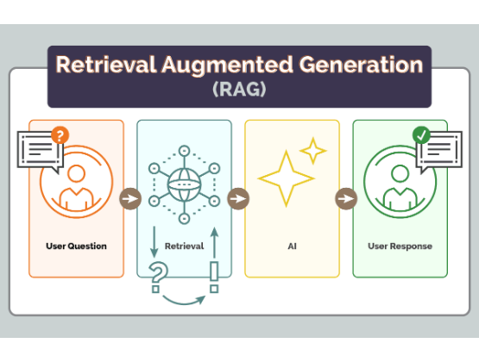
Memory & RAG
▹
Short-Term Memory: Immediate conversation history passed within the context window. Essential for fluid interactions but strictly limited by token caps.
▹
Retrieval-Augmented Generation (RAG): Connecting the agent to enterprise data by converting documents into vector embeddings.
▹
Semantic Search: When the agent needs information, it runs a similarity search against a Vector DB to retrieve only the most relevant document chunks.
▹
Episodic Memory: Advanced agents now write summaries of past interactions to a database, learning user preferences over time.

Slide 11




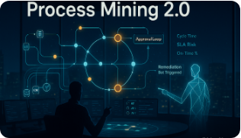
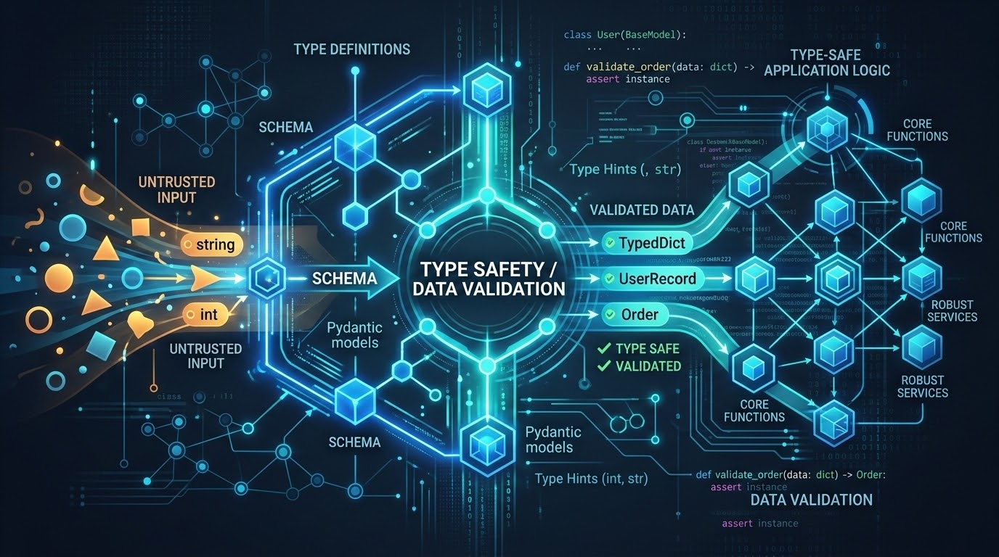

Top 2026 Frameworks
LangGraph
Pydantic AI
CrewAI
The industry default for complex, stateful workflows. Represents agents as graphs, providing control over cycles, branching, and human-approval gates.
Rising rapidly in 2026 for Python teams that prioritize type safety, data validation, and structured outputs without heavy orchestration overhead.
The most approachable framework for building role-based multi-agent teams. Excellent for delegating tasks among specialized AI personas.

Slide 12
Part 3: Implementation
Bridging the gap between conceptual architecture and deployed code.

Slide 13

Security & Governance
▹
The Threat Vector: Autonomous execution means agents can accidentally modify databases or leak PII if not properly constrained.
▹
Model Context Protocol (MCP): An emerging 2026 standard acting as a "USB-C" for AI, safely standardizing how agents connect to local files and enterprise environments.
▹
Observability: Trace monitoring (via tools like Langfuse) is mandatory. Developers must audit exactly which tool an agent called and why it made that decision.
▹
Human-in-the-Loop (HITL): Critical actions (e.g., executing transactions, sending emails) require architectural checkpoints for human approval.

Slide 14




Interactive Labs
These guided labs are hosted externally. Please follow the repository instructions to set up your local or cloud environments.
Lab 1: Foundations
Lab 2: Advanced Orchestration
Microsoft's AI Agents for Beginners
MongoDB, Gemini & LangGraph Lab
A 12-lesson curriculum covering the fundamentals of building agents from scratch using Python. Perfect for understanding the underlying ReAct loop and basic tool calling.
A self-contained GitHub Codespace lab. You will build a production-grade agent utilizing stateful graphs (LangGraph), Vector databases (MongoDB), and external APIs.

Slide 15
Questions?
Open floor for discussion on agentic design patterns.

